Slide 1
37th Annual William E. “Pinky” Newell Address
76th EATA Meeting
January 6, 2024
Mashantucket, CT

Slide 2
Disclosures

Slide 3
No Mandates

Slide 4
Happy 75th!!!!

Slide 5
Goals
1. How did we get here
2. Where do we go from here
3. Call for action

Slide 6
Many Milestones in 2024
1984 – He gave the Keynote Address at Nashville Meeting
40th anniversary of his death is October 13th of this year

Slide 7
Pinky reflected:

Slide 8
William E. “Pinky” Newell
True visionary:
Education
Credentialing
Scholarship

Slide 9
What “O” thought
“Pinky would plant the seed and watch others tend to it. But if it was not sprouting as fast as he thought it should, he’d put a little ‘fertilizer’ on it”

Slide 10
Education:
Bud’s father was MD and director of Student Health at Purdue
Pinky’s team MD

Slide 11
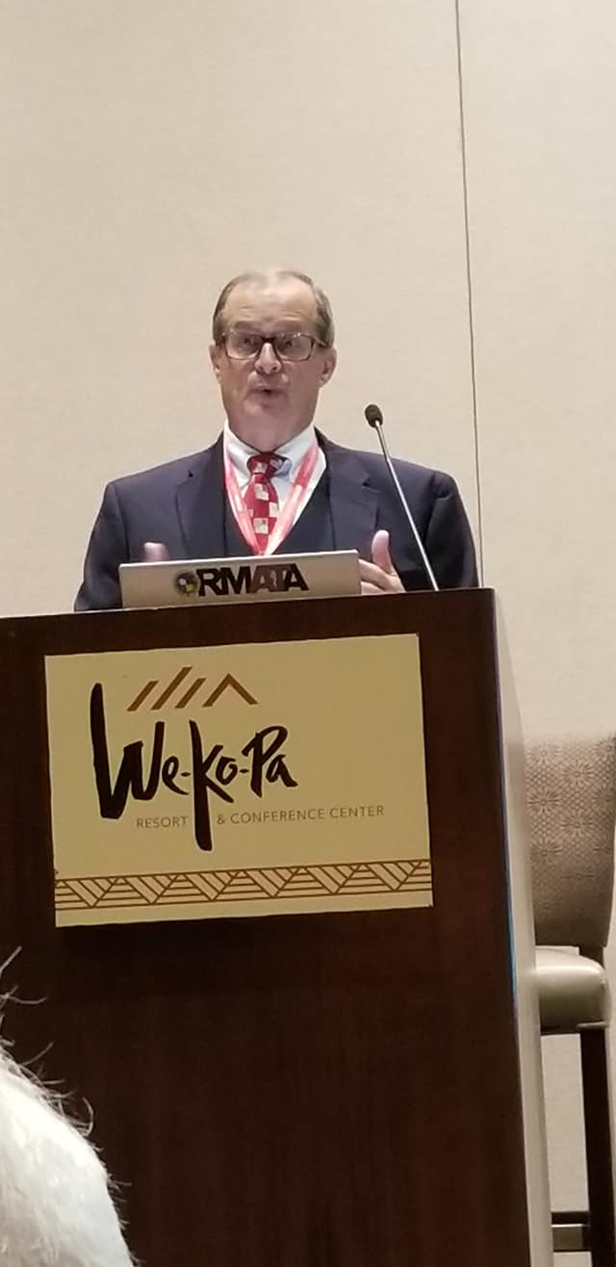
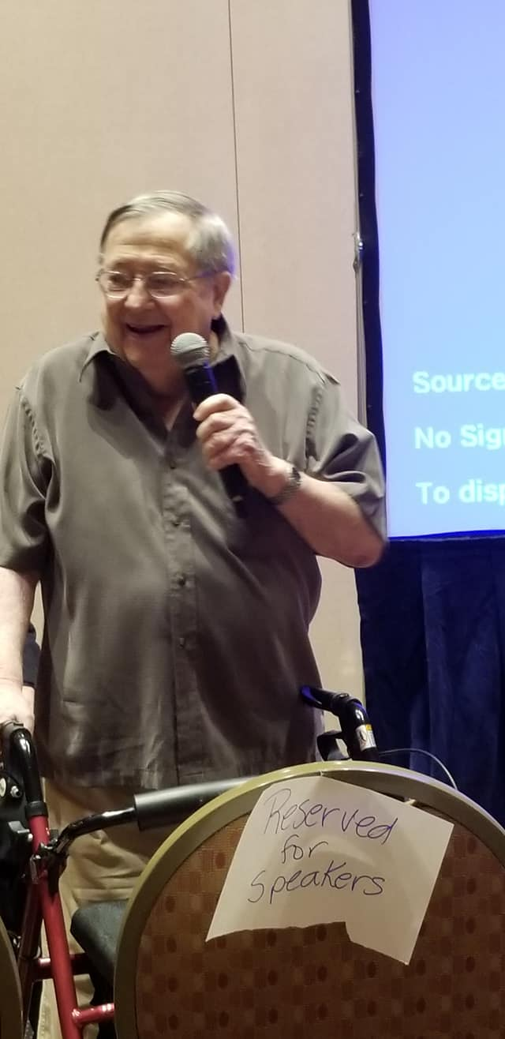
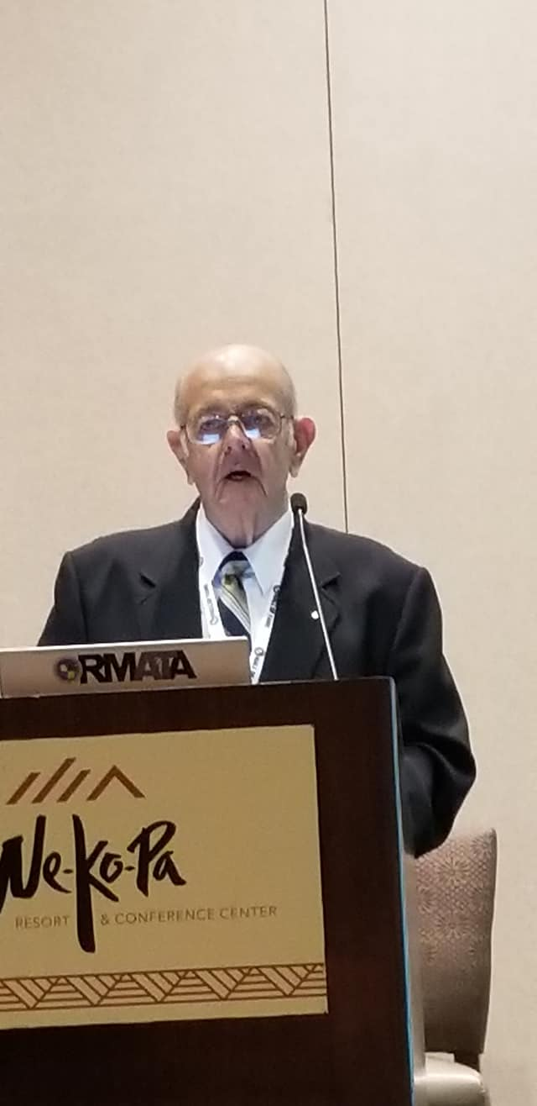
Mt. Rushmore of AT Education
John Shrader
Indiana University
Gary Delforge
University of Arizona
Bob Behnke
Indiana St University

Slide 12
Early Educational Programs
1959 – essentially a pre PT program
1970 – The First Four
Indiana State – only program to admit women
Lamar
Mankato State
University of New Mexico
1973 – 14 programs – 2 graduate programs
Indiana State
University of Arizona
First major – 1979-80 – Central Michigan University

Slide 13
Evolution of our Education:
Initially in PE aligned with coaches and Phys Ed programs
“Are our programs purely educational or are the students still providing a workforce” Pete Koehneke - Pinky Newell 2005
As of Fall term 2022 - Entry Level Master Degree
Programs are now found in Schools of Public Health and/0r with other Allied Health Professions - we provide health care!!!!

Slide 14
JRC-AT incorporated 1991
June 2006 became the CAATE
Accredits professional programs in AT

Slide 15
Credentialing because of a football game?

Slide 16
You wrote it, you can make it happen

Slide 17
20th Anniversary
Jeff Ryan past President of the BOC
2004 Pinky Newell Addressee
End of the internship route

Slide 18
Evolution of Credentialing
The first exam in 1970
Graduates of PT School with health/PE minor – 2 years of supervised Clinical Education
College graduate with Core Course work and 1800 hours of Clinical Education – AKA internship
Graduate from approved program – 2 years of supervised Clinical Education
Graduate from CAATE accredited entry level program

Slide 19
Incorporated in 1989
Certification program for requirement entry level AT profession
Establish standards for the practice & CEU requirements the BOC ATC

Slide 20
Scholarship & Research

Slide 21
1970 – first $250 scholarship
1982 – 20 - $500
1991 - Incorporated
2023 – 50-75 @$2300
Thru 2023 - $4M in scholarships
$5.45M in research to 385

Slide 22
Engaging our future

Slide 23
“was founded with a mission to build and strengthen the profession of athletic training through the exchange of ideas, knowledge, and methods of athletic training. “

Slide 24
“is to represent, engage and foster the continued growth and development of the athletic training profession and athletic trainers as unique health care provider”

Slide 25
From West Lafayette Greenville, NC
Omaha, NE
Washington, DC
Dallas, TX

Slide 26
NATA

Slide 27
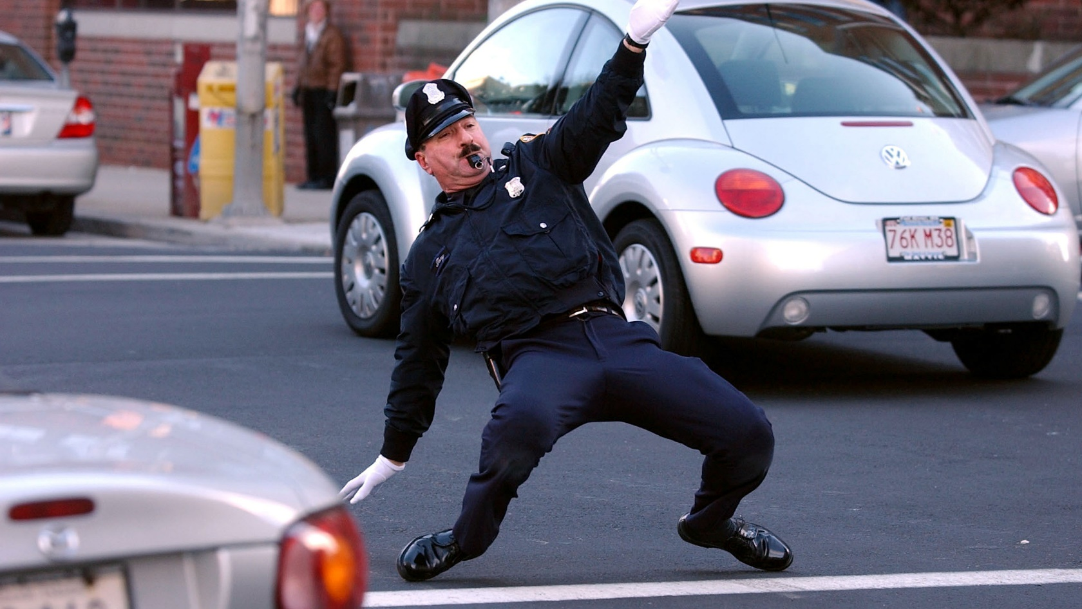
NATA

Slide 28
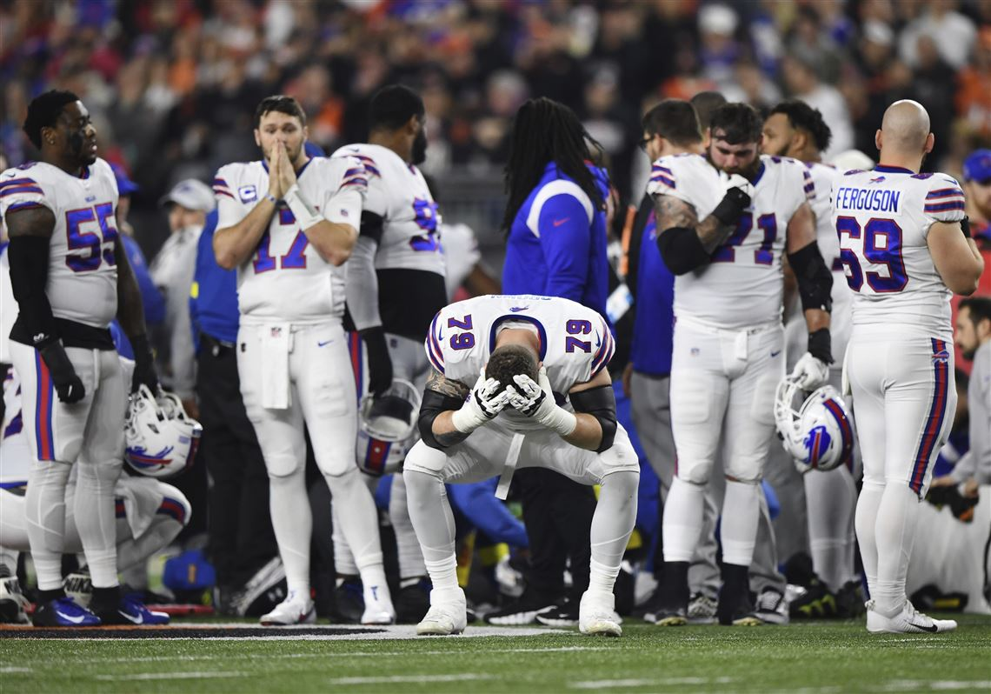
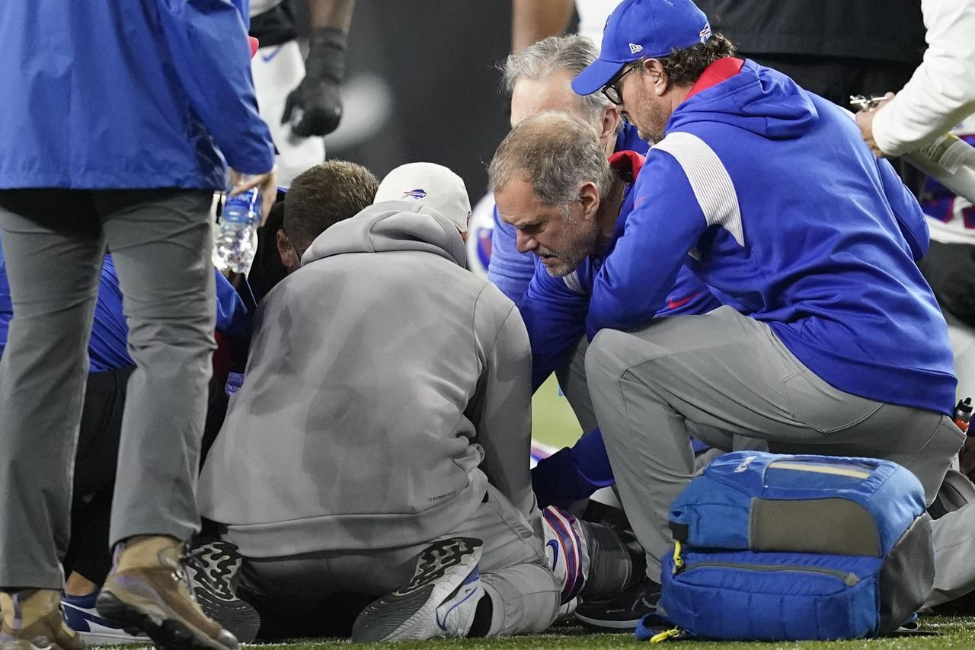
1st Anniversary

Slide 29
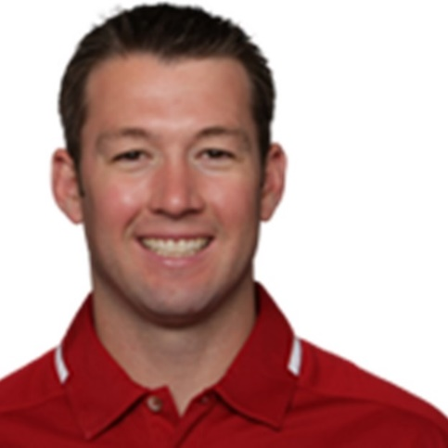
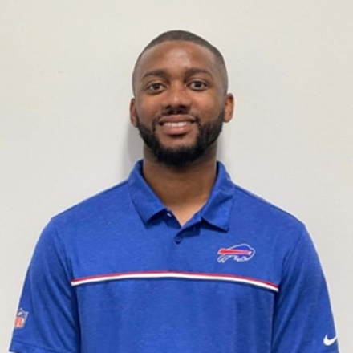
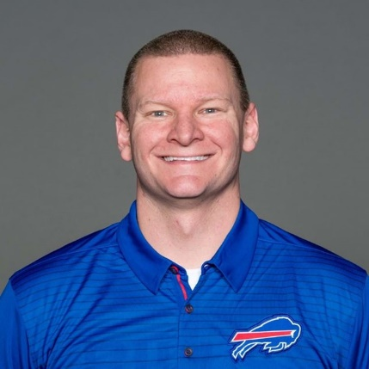
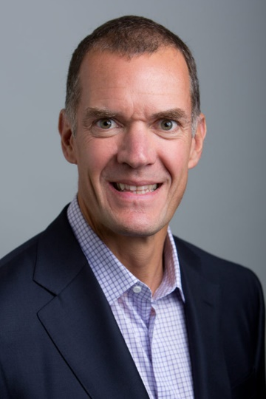
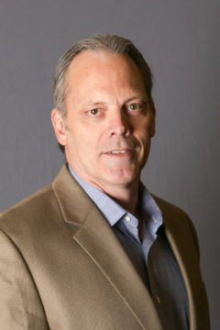
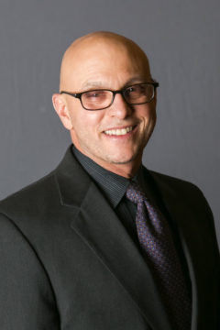
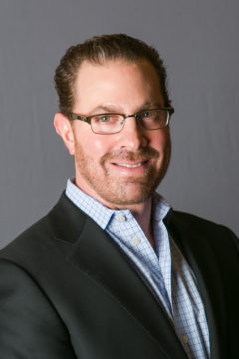
Monday Night Heroes
Nate Breske DPT,,ATCC
Denny Kellignton DPT, ATC
Tabinin Richards MS, ATC
Leslie Brisson, MD
Marc Fineberg, MD
Thomas White, MD
Andrew Cappuccino, MD

Slide 30
1st Anniversary
January 5th
Ashari Hughes
16 yo Desert Oasis HS
Las Vegas, NV
Rare cardiac congenital abnormality

Slide 31
1st Anniversary
January 5th
Army Ice Hockey Player Eric Huss – Neck Laceration
Rachael (Leahy) Ross ATC

Slide 32
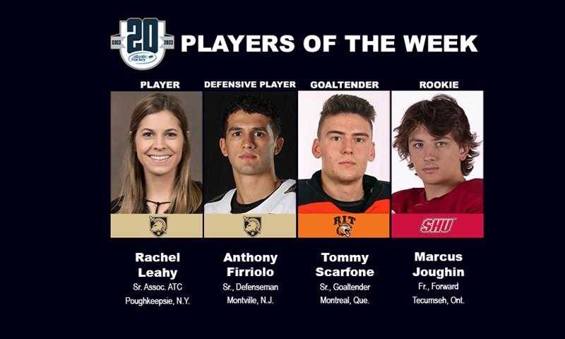

Slide 33
We Are Here for You

Slide 34
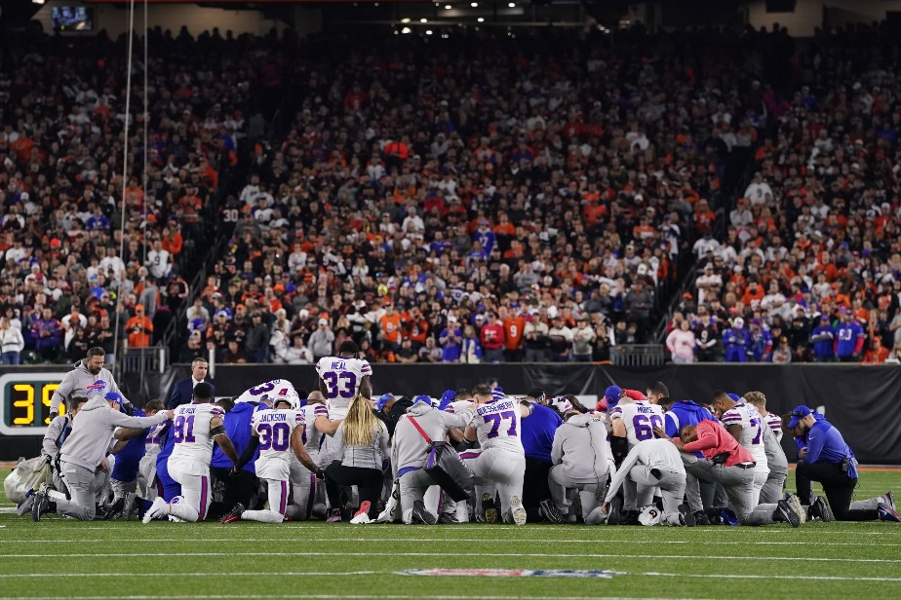
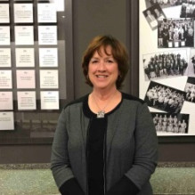
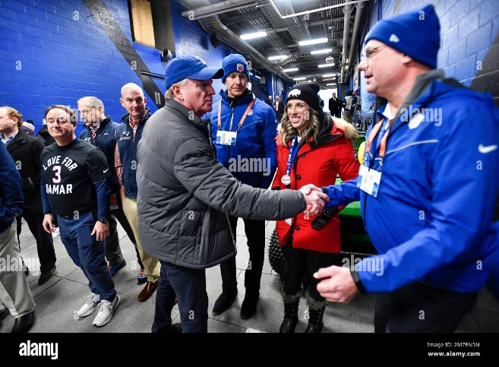
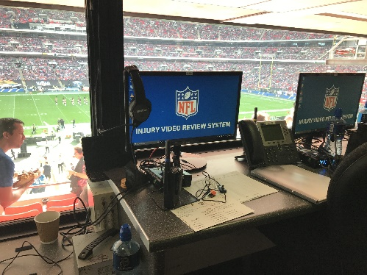
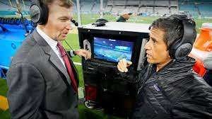
“This woman has the power to stop an NFL game.” CNN

Slide 35
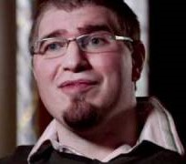
Progress
March 2011 - E60
Preston Plevertes
Mike Tirico
Sunday Night FB
April 2023 - OTL
Rachel Ross

Slide 36
Our own Aimee Brunelle
May 2022 – State Licensure
August 2023 – EAP
Oct 2023 – Concussion Awareness

Slide 37
Governmental Affairs
Legislative boot camps
3rd Party Reimbursement
Sports Medicine Licensure Clarity Act - 2018

Slide 38
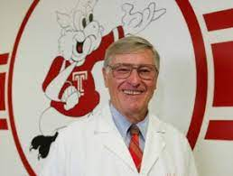
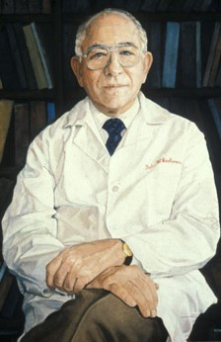
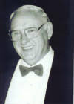
50th Anniversary

Slide 39
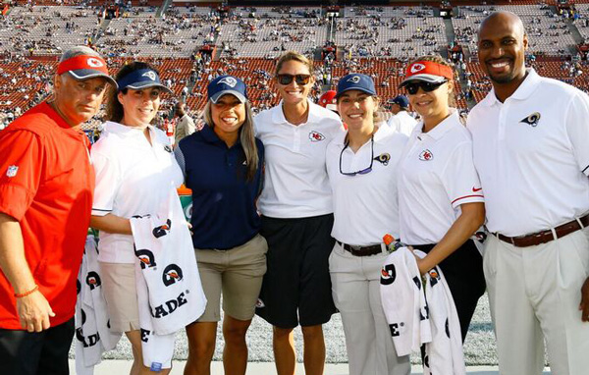
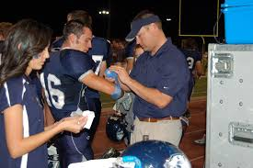
Where do you want to work???

Slide 40
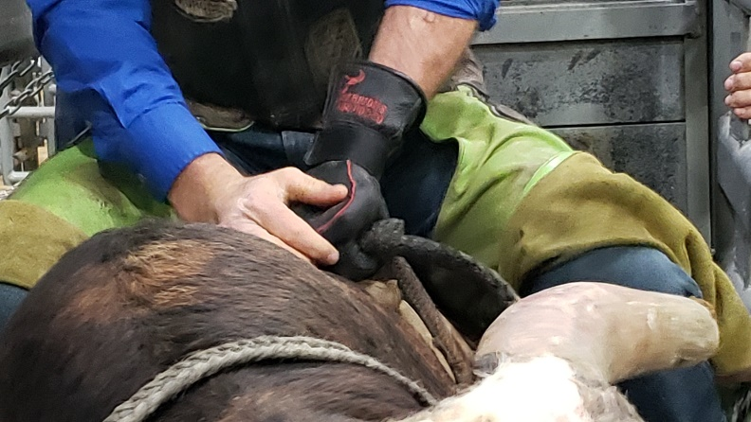
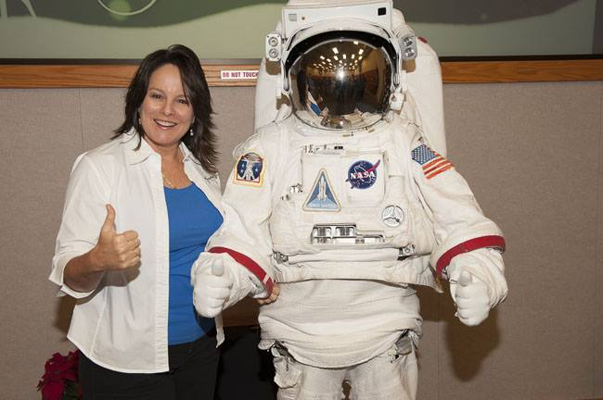
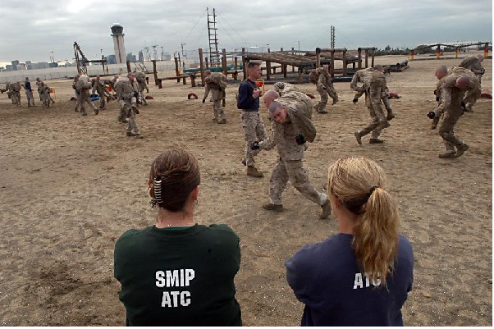
Where do you want to work???

Slide 41
Life is not a bed of:

Slide 44
5 Generations in the Workforce
2%
25%
33%
35%
5%

Slide 45
Socrates Triple Filter Test (+)
Are you sure that it is truthful?
Is what you are about to say is it good?
Is it going to be useful?
AJ’s addition – Best not done in public

Slide 47
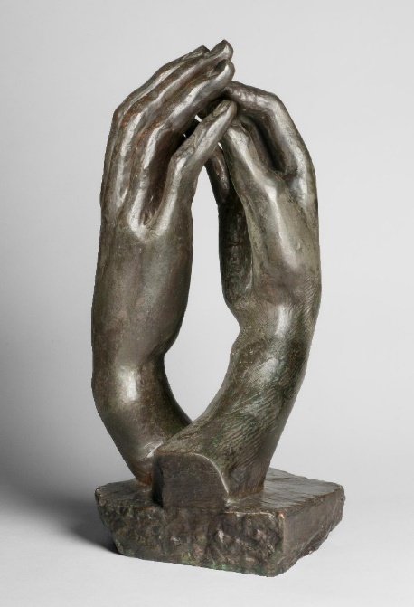
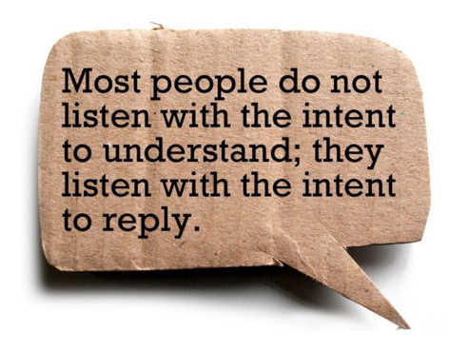

Slide 48
In Conversation
We must be:
ACTIVELY ENGAGED

Slide 50
“Be involved in the profession” Dale Mildenberger MS, ATC, Utah St NATA HOF 1984

Slide 51
“We have to make sure we adapt [our education] to the job market. It's not certain where all our jobs are going to be 15 years from now. As the health-care industry changes, we have to be on our guard against complacency and continuing to educate people the way we always have" Lindsy McLean - 1999

Slide 52
“On a day-to-day basis, the changes in our Association in the future will be neither dramatic or sudden. Their impact will be historical, not contemporary. They will come if we exercise the kind of wisdom, prolonged effort, and patience that go along with looking ahead to what the profession and the Association will be ten years or even another thirty-five years from now. We must work diligently and honestly for what many of us may not live to see” Pinky 1984

Slide 53
Must look to the future

Slide 54
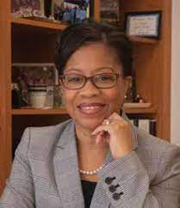
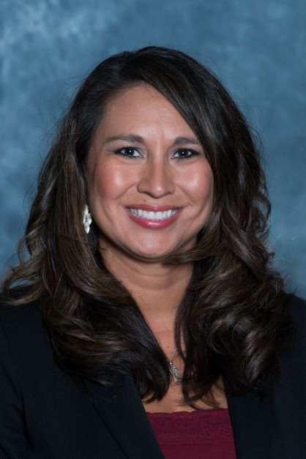
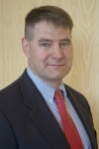
AT 2050

Slide 55
Actively Engaged

Slide 56
So lets “Pass A good Time” NATA 75th

Slide 57
Beat Washington

